Slide 1
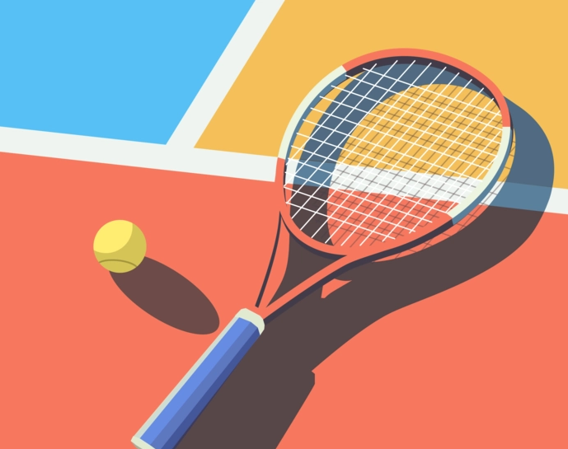
SUBJECT : DATA VISUALIZATIONS
TITLE : TENNIS ANALYSIS
~Vishwa Prasad

Slide 2
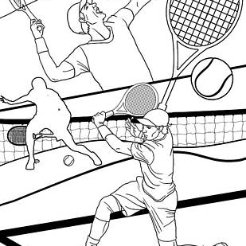
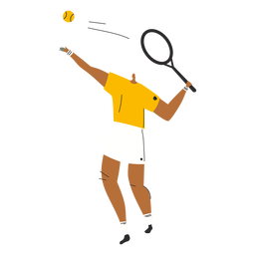
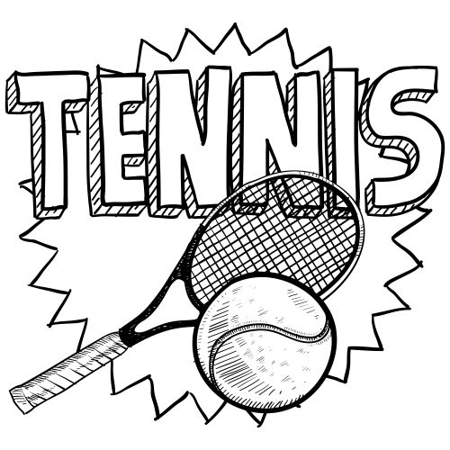
CONTENTS
Features / Glossary
Player Report/Profile
Detailed Analysis
Player Comparison
Current Rankings
G.O.A.T conversation
G.O.A.T Analysis
Conclusion
Acknowledgements

Slide 3
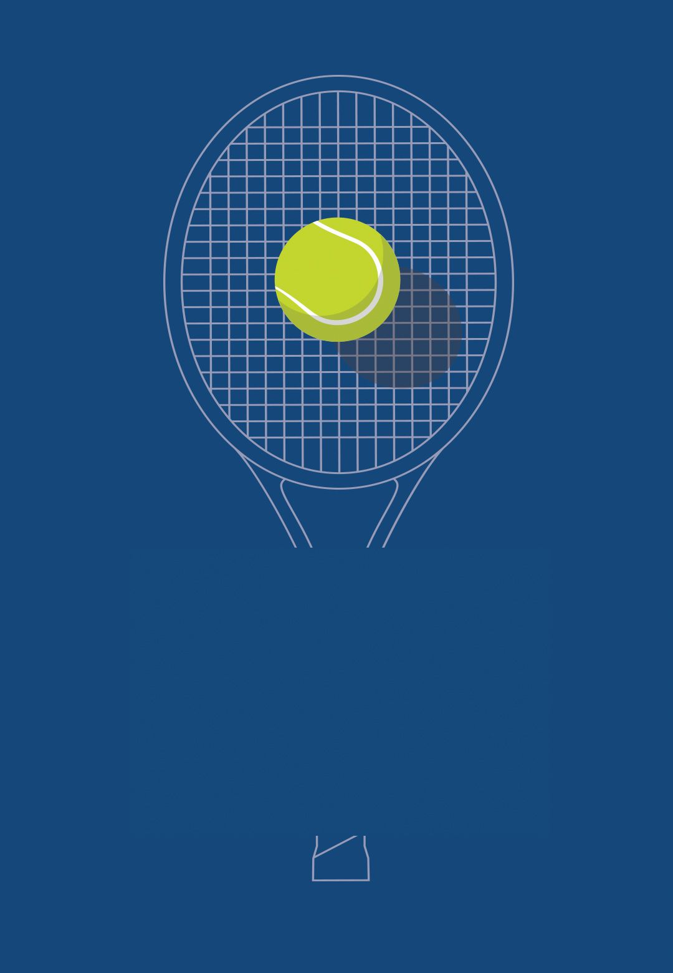
ATP - stand for the Association of Tennis Professionals
Ace - a serve that is a winner without the receiving tennis player able to return the ball.
Break - when the server loses the game
Break point - one point away from breaking serve
Court - Clay, Carpet, Grass, Hard
Deuce - when the score in a game is 40 to 40.
Double Fault - two missed serves in a row. The server will lose the point.
Fault - a service that is not in play.
First Service - the first of the two serves of a tennis ball a player is allowed.
Game point - one point away to win the tennis game.
Grand Slam - any one of the four most prestigious tennis tournaments including the Australian Open, the French Open, Wimbledon and the U.S. Open.
Match point - when one tennis player only needs one more point to win the entire match
Second Service - the second serve that the server is allowed after missing the first serve. This serve must be successful, or the server will lose the point (called a double fault).
GLOSSARY

Slide 4

OBJECTIVE 1
Analyze a player’s stats throughout his career

Slide 5
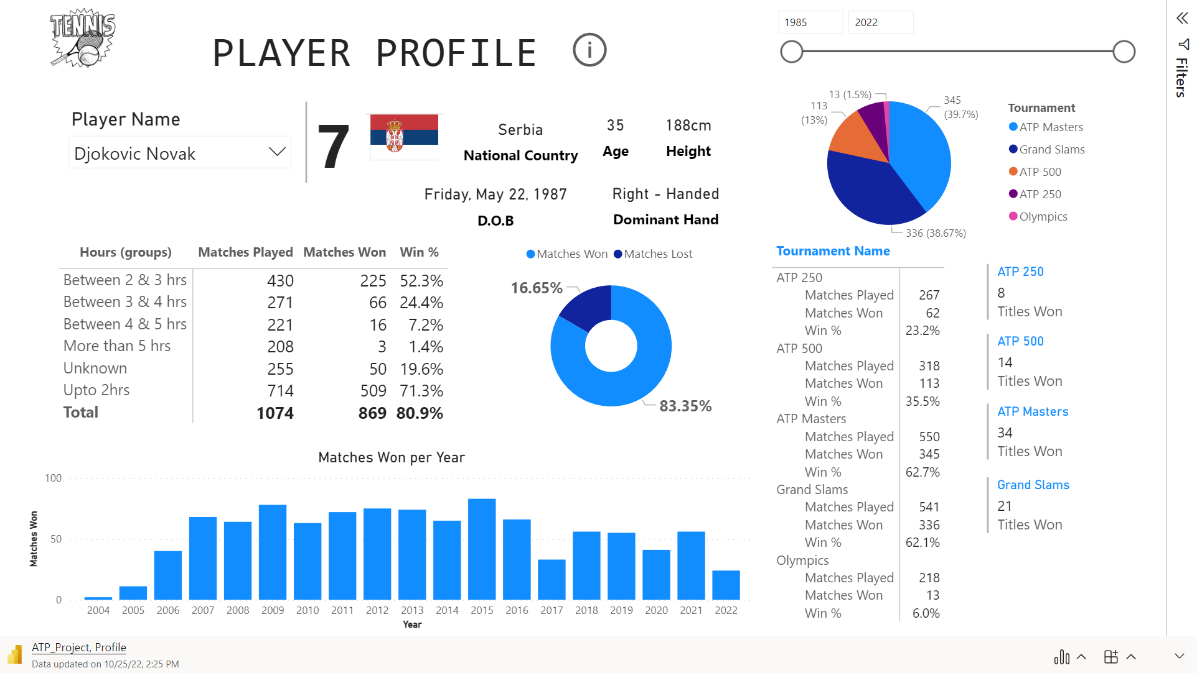

Slide 6
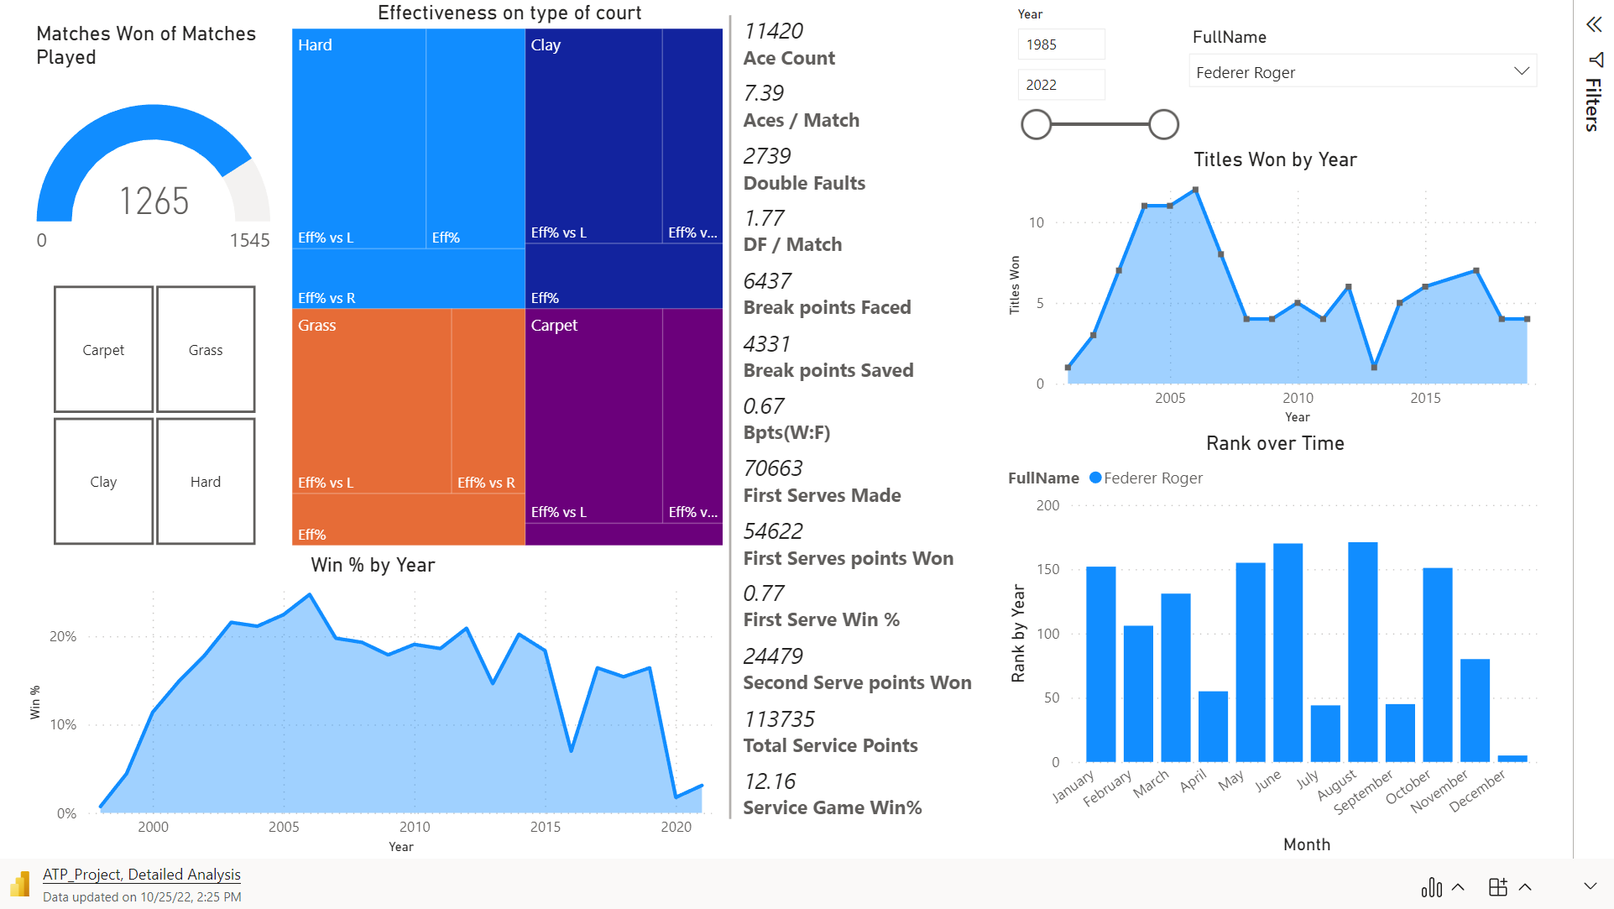

Slide 7

OBJECTIVE 2
Compare 2 Players and analyze the number of titles and matches won in their carrer

Slide 8
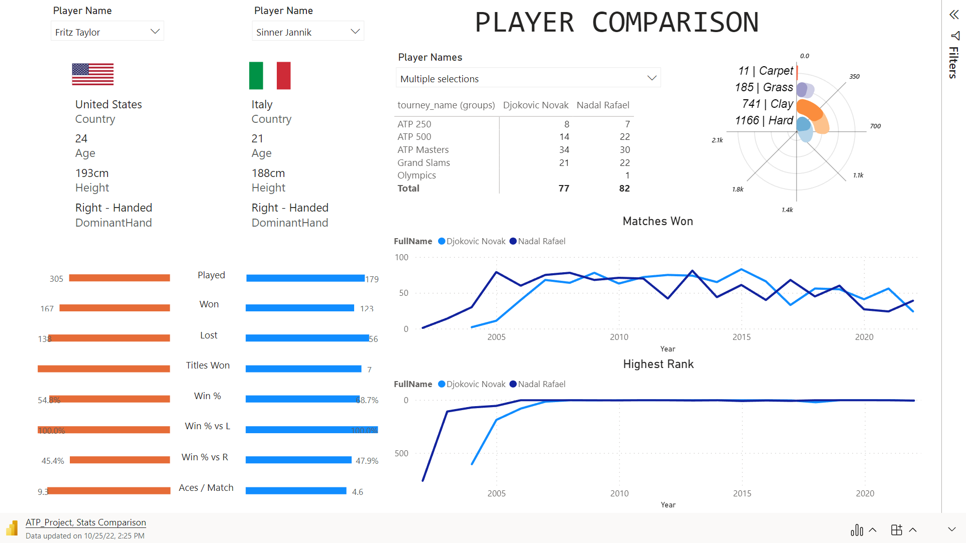

Slide 9
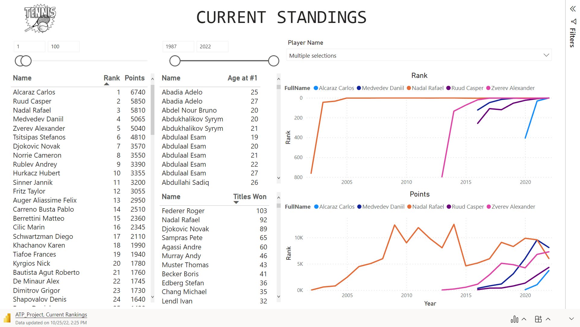

Slide 10
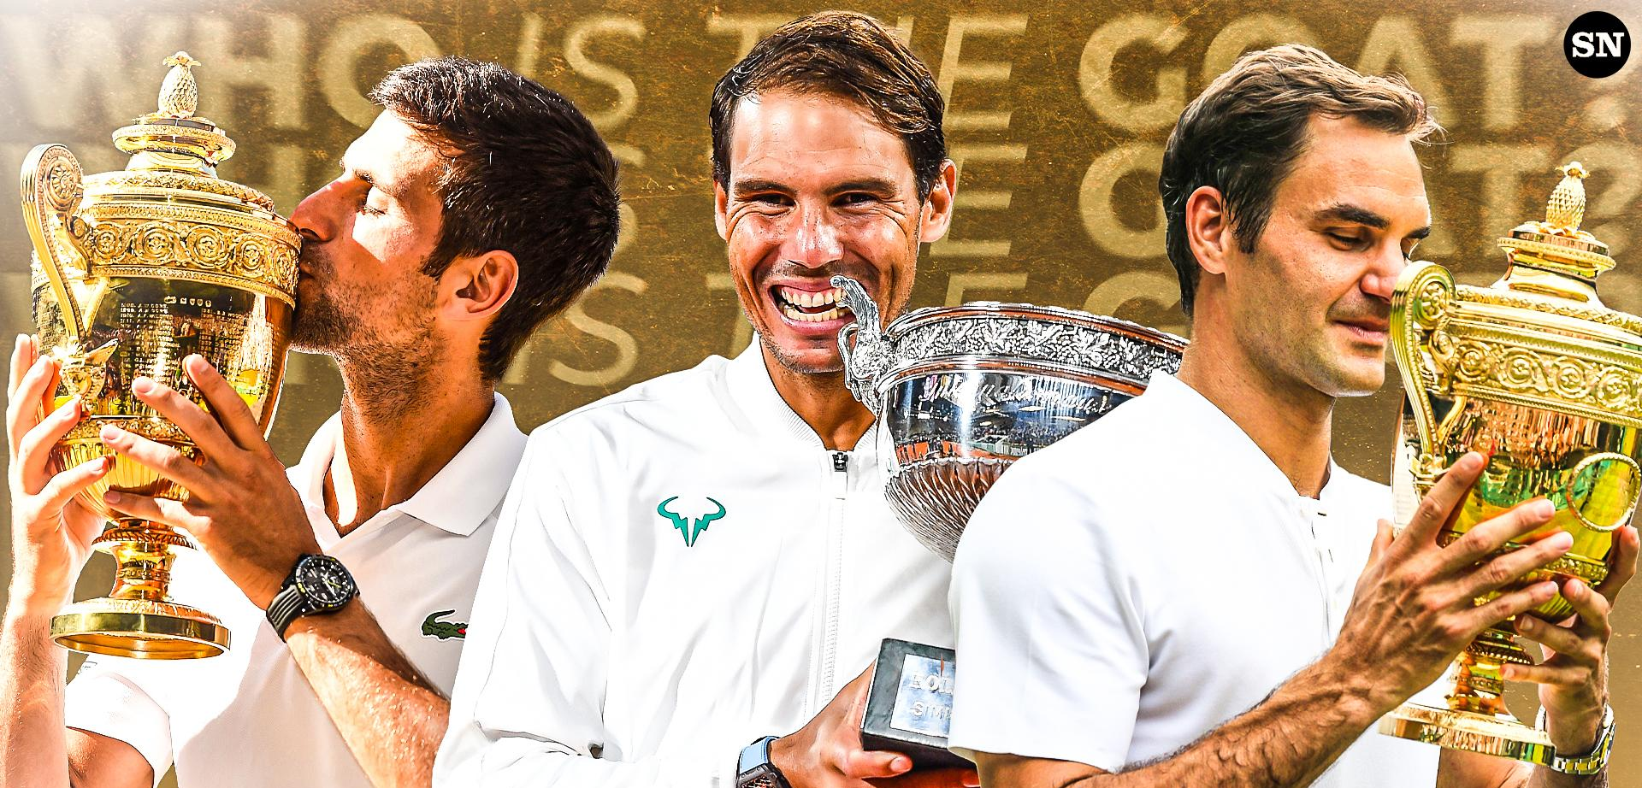

Slide 11
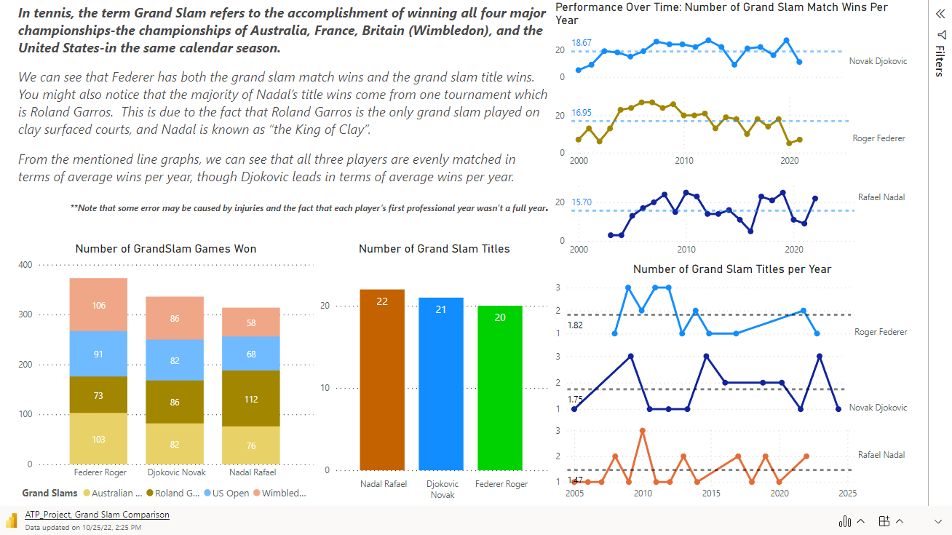

Slide 12
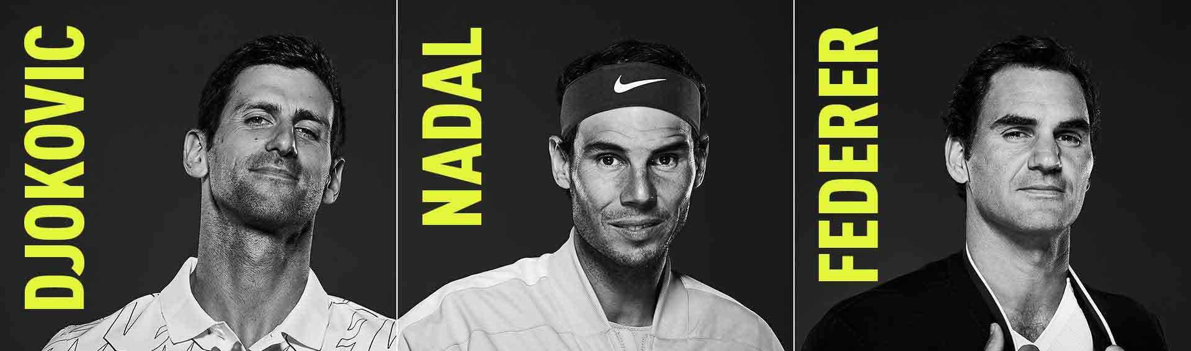
The trio of Roger Federer, Rafael Nadal and Novak Djokovic dominated throughout the last two decades that no other tennis player managed to make their way into the discussion.
The three won 62 of the last 76 Grand Slams in men's tennis with Nadal (22) leading the Slam list followed by Djokovic (21) and Federer (20).
The greatest grass court player of all time is Roger [Federer], the greatest hard-court player is Novak [Djokovic] and the greatest clay court player is Rafa [Nadal].

Slide 13
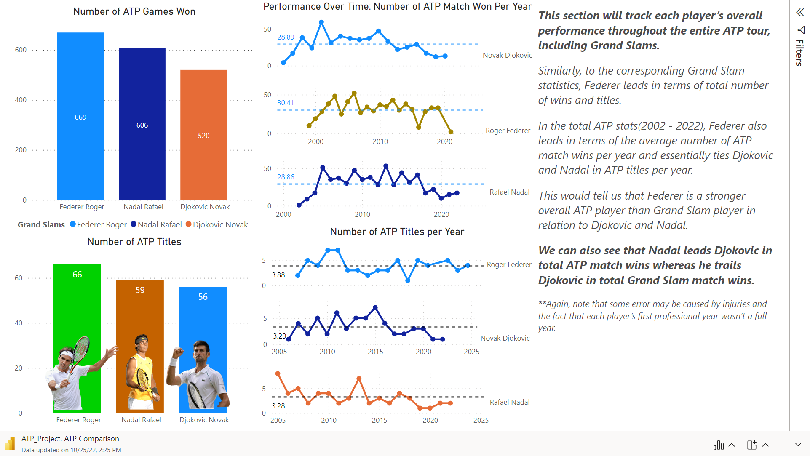

Slide 14
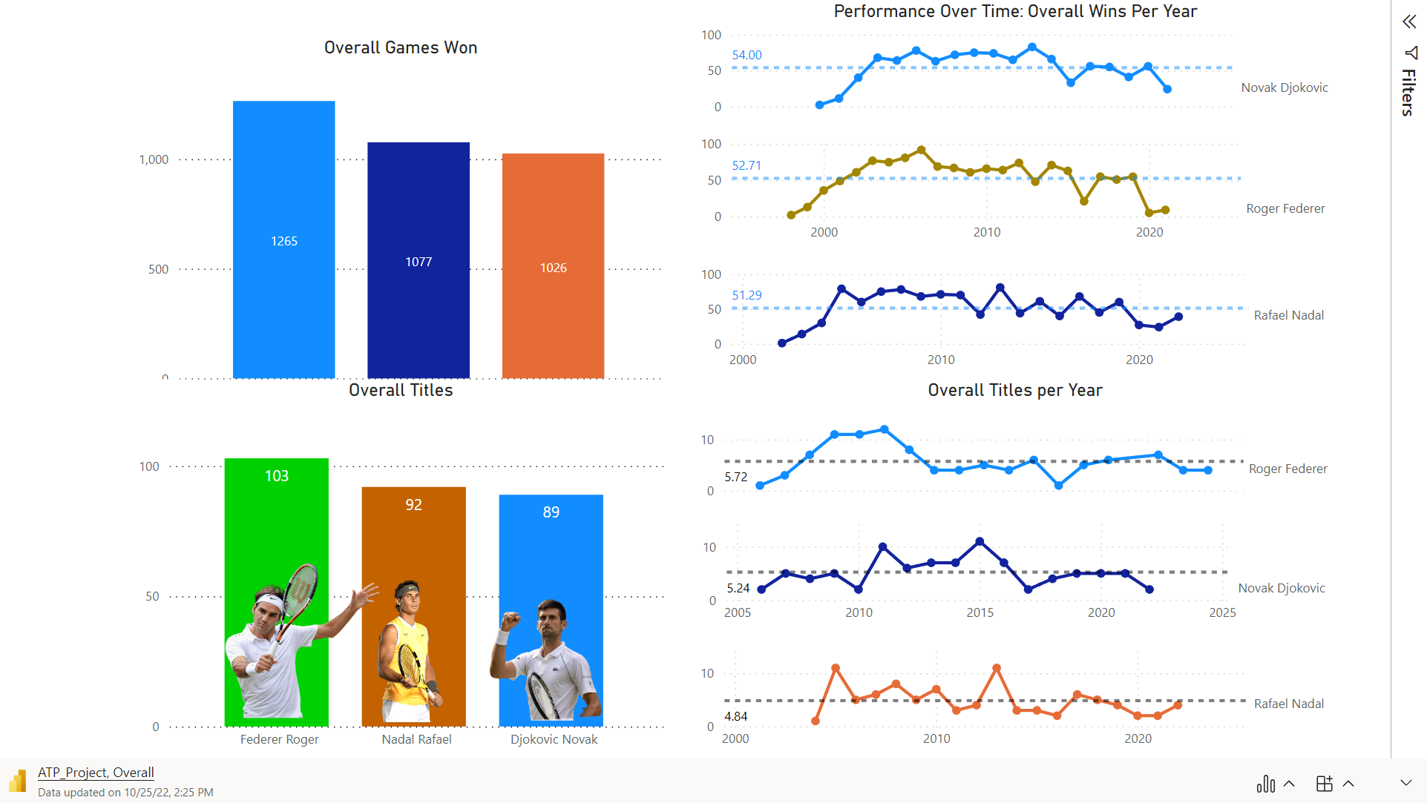

Slide 15
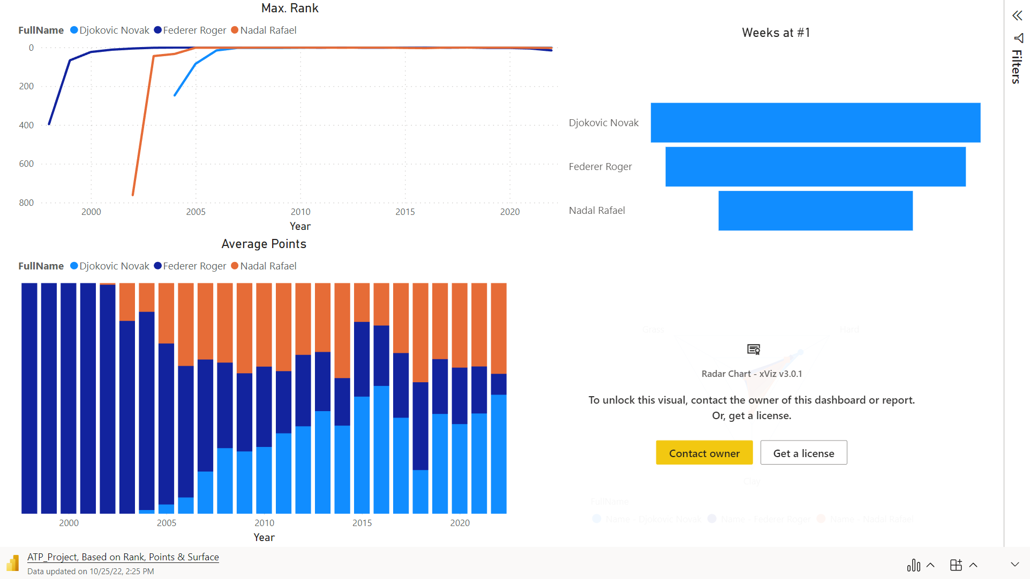

Slide 16
CONCLUSION
Nadal at the top with 22, Djokovic following him with 21 and Federer calling it a day at 20.
However, Nadal’s unreal level on clay has helped him win 14 titles at Roland Garros and arguably inflated his overall Slam count.
While Nadal’s dominance on clay is quite unprecedented and deserves utmost credit, it drags him back somewhat in the race for the GOAT.
Now, Nadal has won eight slams off clay. This points out Nadal’s brilliance on hard courts quite well; the only thing is that it still fades in comparison to that of Federer and Djokovic.
Djokovic leads the list with 38 Masters 1000 titles followed by Nadal with 36 and Federer with 28.
Djokovic and Federer have won 12 and 11 Grand Slams on hard courts, respectively, but Djokovic is comfortably ahead in terms Masters titles won on the surface.
Federer noses ahead in terms of Wimbledon counts (eight against seven*), but Djokovic might very catch-up next year, given the apparent inability of the younger players to play on grass.
Overall, Djokovic has the most accomplished resume of the three and is likely to add more as he is relatively injury-free and can play more tournaments on hard courts, his favorite surface.
In Conclusion, based on my analysis I’d say the Current G.O.A.T is Roger Federer and Projected G.O.A.T is Djokovic

Slide 17

ACKNOWLEDGEMENT
https://github.com/JeffSackmann/tennis_atp
https://www.atptour.com/
https://count.co/report/j0OYDOaWDmn?frame=3R3BdGZv1Gm

